Slide 1


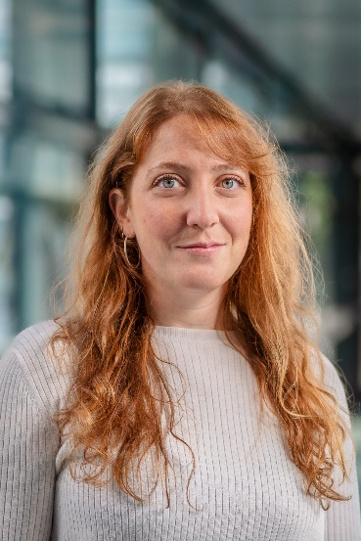
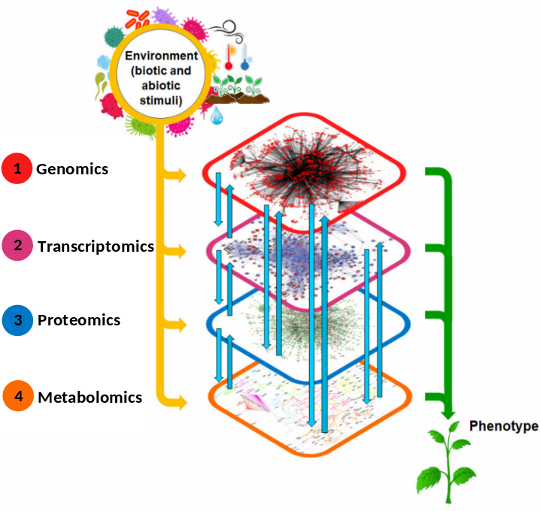
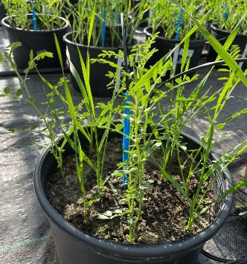
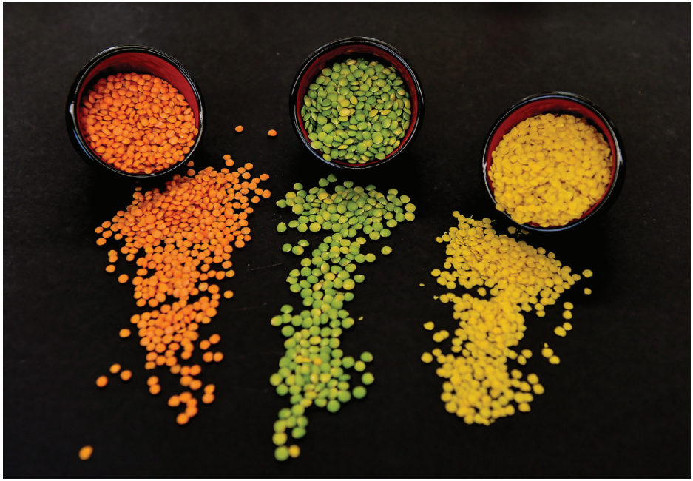
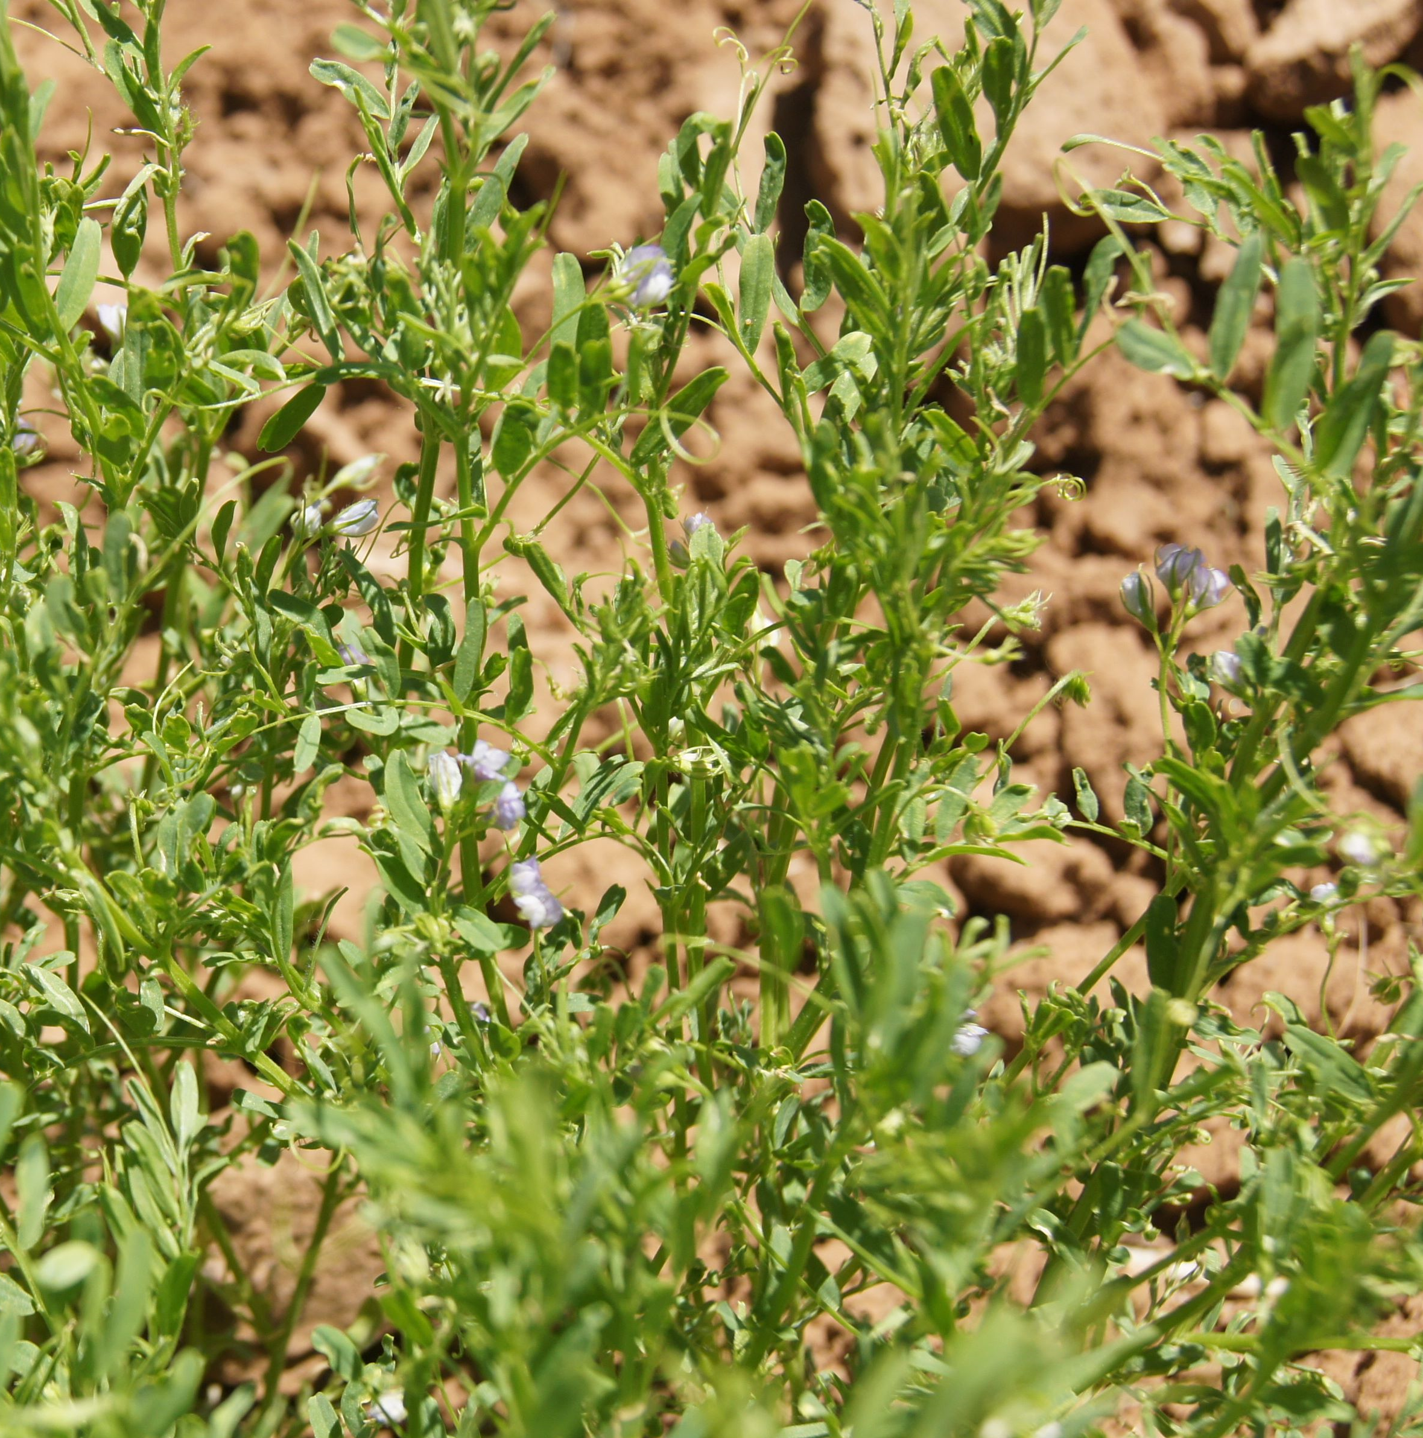
Università Politecnica delle Marche
Legume Generation: Boosting innovation in breeding for the next generation of legume crops for Europe
Thursday May 21th h. 09:00 Room H
Dipartimento di Scienze Agrarie, Alimentari ed Ambientali D3A
The use of mass spectrometry-based metabolomics in genetic studies: applications to dissect genetic
diversity and adaptation in legumes
Chiara
SANTAMARINA
PostDoc at Università Politecnica delle Marche
PhD researcher at Max Planck Institute of Molecular Plant Physiology
Per informazioni contattare: Prof. Elena Bitocchi, email: e.bitocchi@univpm.it - Tel. 071 2204280

